Slide 2
The Journey Begins

Slide 3
Why?
Clarify the vision

Slide 4
To Model or not To Model

Slide 5
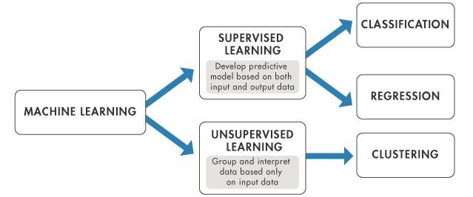
Types

Slide 6
Learning from Maths Destruction
Making sure the model re-trains with new data

Slide 7
The Big Show

Slide 8
Being Agile and Prototyping

Slide 9
That was the end
For now

Slide 10
The journey begins again

Slide 11
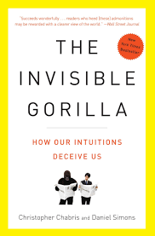

Slide 12
QUESTIONS?

